Slide 1
CSE 223 Electronic Devices and Circuits Lecture - 2
Prepared by
Ipshita Tasnim Raha Lecturer Dept. of Computer Science & Engineering Varendra University Contact: ipshita@vu.edu.bd

Slide 2
(review)
Impurities
Donor
Impurity
Acceptor Impurity
Excess Electrons
Pentavalent elements
n-type impurity
(+)ve carrier (holes)
Trivalent elements
p-type impurity

Slide 3
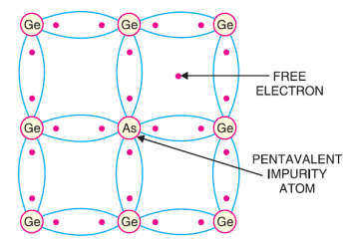
n-type semiconductor
When a small amount of pentavalent impurity is added to a pure semiconductor, it is known as n-type semiconductor.
The addition of pentavalent impurity provides a large number of free electrons in the semiconductor crystal.
Typical examples of pentavalent impurities are arsenic (Atomic Number 33) and antimony (Atomic Number 51).
Such impurities which produce n-type semiconductor are known as donor impurities because they donate or provide free electrons to the semiconductor crystal.

Slide 4
n-type semiconductor
To explain the formation of n-type semiconductor, consider a pure germanium crystal. We know that germanium atom has four valence electrons. When a small amount of pentavalent impurity like arsenic is added to germanium crystal, a large number of free electrons become available in the crystal.
The reason is, Arsenic is pentavalent that is, its atom has five valence electrons. An arsenic atom fits in the germanium crystal in such a way that its four valence electrons form covalent bonds with four germanium atoms. The fifth valence electron of arsenic atom finds no place in co-valent bonds and is thus free.
Therefore, for each arsenic atom added, one free electron will be available in the germanium crystal. Though each arsenic atom provides one free electron, yet an extremely small amount of arsenic impurity provides enough atoms to supply millions of free electrons.

Slide 5
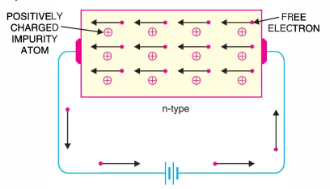
n-type semiconductor conductivity

Slide 6
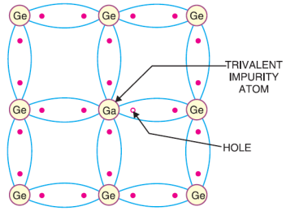
p-type semiconductor
When a small amount of trivalent impurity is added to a pure semiconductor, it is called p-type semiconductor.
The addition of trivalent impurity provides a large number of holes in the semiconductor.
Typical examples of trivalent impurities are gallium (Atomic Number 31) and indium (Atomic Number 49).
Such impurities which produce p-type semiconductor are known as acceptor impurities because the holes created can accept the electrons.

Slide 7
p-type semiconductor
To explain the formation of p-type semiconductor, consider a pure germanium crystal.
When a small amount of trivalent impurity like gallium is added to germanium crystal, there exists a large number of holes in the crystal. The reason is, Gallium is trivalent that is, its atom has three valence electrons. Each atom of gallium fits into the germanium crystal but now only three covalent bonds can be formed. It is because three valence electrons of gallium atom can form only three single co-valent bonds with three germanium atoms.
In other words, fourth bond is incomplete being short of one electron. This missing electron is called a hole. Therefore, for each gallium atom added, one hole is created. A small amount of gallium provides millions of holes.

Slide 8
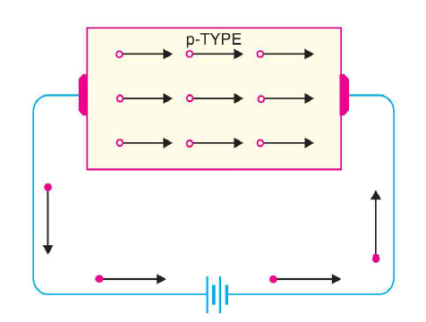
p-type semiconductor Conductivity

Slide 9
Charge on P-type and n-type Semiconductors
It is true that n-type semiconductor has excess of electrons but these extra electrons were supplied by the atoms of donor impurity and each atom of donor impurity is electrically neutral.
When the impurity atom is added the term excess electrons refers to an excess with regards to the number of electrons needed to fill the covalent bonds in semiconductor crystal.
The extra electrons are free electrons and increase the conductivity of the semiconductor. This situation with regard to p-type semiconductor is also similar.
So it follows, therefore that n-type as well as p-type semiconductor is electrically neutral.

Slide 10
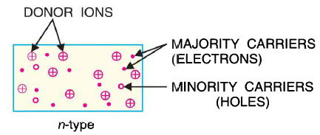
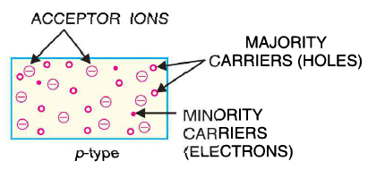
Majority and Minority Carriers
N-type material has a large number of free electrons. And a small number of holes
P-type material has a large number of holes. And a small number of electrons

Slide 11
n-type & p-type conductivity
Graphic demonstration is always helpful
Link: n-type and p-type semiconductors
Notes:
https://www.youtube.com/watch?v=CM0C7gWMcyw

Slide 12
Semiconductor Diode

Slide 13
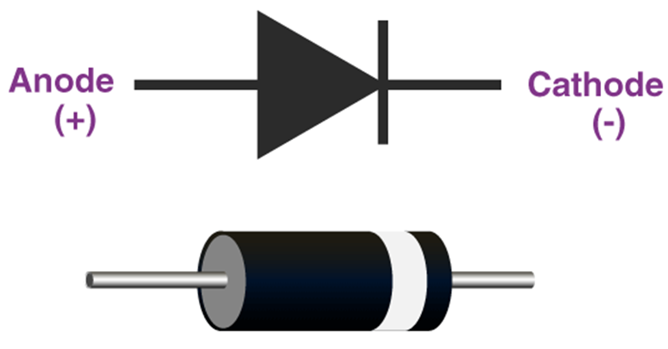
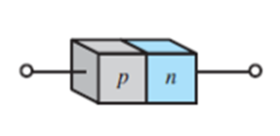
Semiconductor Diode
The semiconductor diode is created by simply joining a p-type and an n-type material together.
When a p-type semiconductor is suitably joined to n-type semiconductor, the contact surface is called pn junction
pn junction is fabricated by special techniques. One common method of making pn junction is called alloying.
This semiconductor diode is represented by the following symbols, where the arrow indicates the direction of positive current flow. These are generally used for rectifiers. It is also called the p-n junction diode.

Slide 14
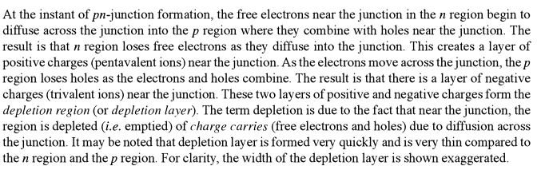
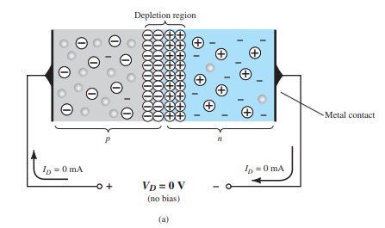
How a pn-junction semiconductor works
Notes:
Ref: Boyelestad book-pg 11 (search 37), Mehta book 67 (search 82)

Slide 15
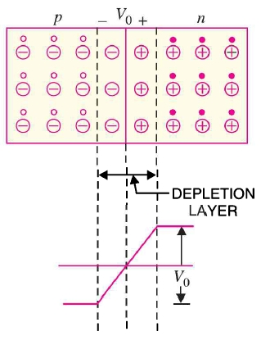
How a pn-junction semiconductor works

Slide 16
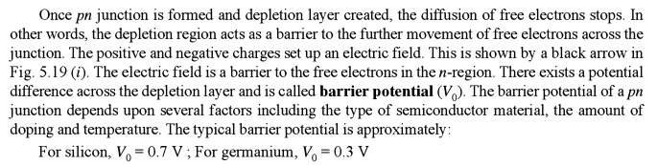
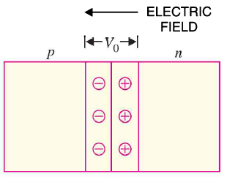
pn-junction of semiconductor
**The number of minority charge carriers depends only on temperature. If temperature increases, minority charge carrier will also increase.
Notes:
Biasing effect the majority carriers
Temperature has impact on minority carriers

Slide 17
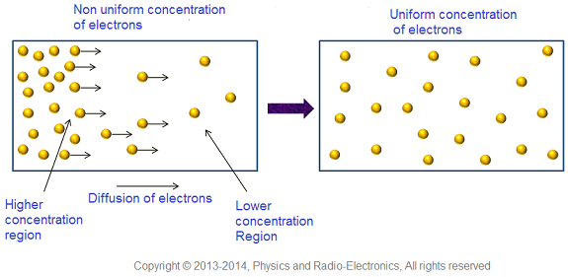
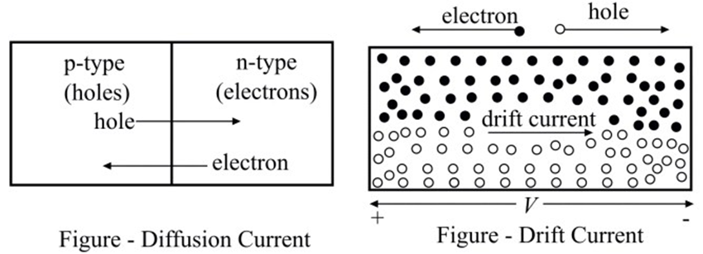
pn-junction of semiconductor
Diffusion current: The process by which, charge carriers (electrons or holes) in a semiconductor moves from a region of higher concentration to lower concentration is called diffusion. Current produced due to motion of charge carriers from a higher concentration to a region of lower concentration is called diffusion current.
Drift current: When the charge carriers move in a semiconductor due to the applied electric field, the resulting current is known as drift current.
Both drift and diffusion current occurs in semiconductor devices.
The direction of diffusion current is same or opposite to that of the drift current.

Slide 18
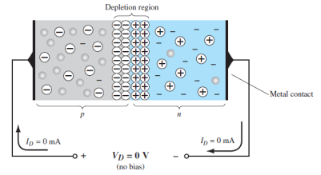
Biasing a pn-junction
The term bias refers to the application of an external voltage or d.c. voltage across the two terminals of the device to establish certain operating conditions.
If leads are connected to the ends of each material, a two-terminal device results as the given picture.
Three operating conditions then become available:
no bias
forward bias
reverse bias

Slide 19
No Applied Bias (VD= 0V)
The condition shown in figure is the no-bias situation because there is no external voltage applied. In the figure it is clear that the applied voltage is 0 V (no bias) and the resulting current is 0 A, much like an isolated resistor. The absence of a voltage across a resistor results in zero current through it.

Slide 20
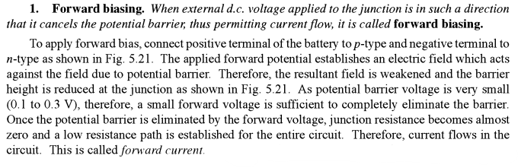
Forward - Bias Condition (V_{D} > 0V)

Slide 21
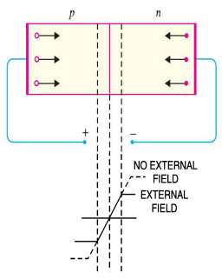
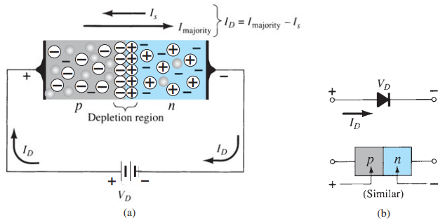
Forward - Bias Condition (V_{D} > 0V)

Slide 22
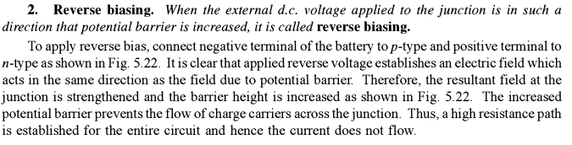
Reverse - Bias Condition (V_{D} < 0V)

Slide 23
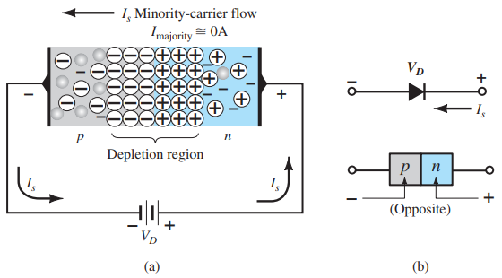
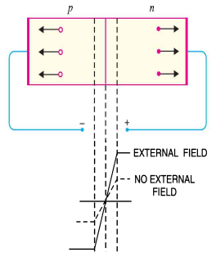
Reverse - Bias Condition (V_{D} < 0V)

Slide 24
Characteristics of Diode:
Diode always conducts in one direction.
Diodes conduct current when Forward Biased (Zero resistance)
Diodes do not conduct when Reverse Biased (Infinite resistance)

Slide 25
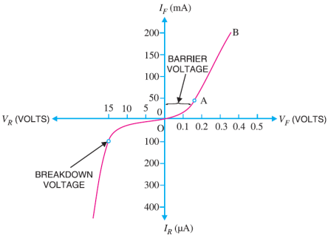
V-I Characteristics of pn junction
Volt-ampere or V-I characteristic of a p-n junction is the curve between voltage across the junction and the circuit current. Usually, voltage is taken along x-axis and current along y-axis.
The characteristics can be studied under three heads
Zero external voltage
Forward bias and
Reverse bias

Slide 26
V-I Characteristics of pn junction
Zero external voltage: When the external voltage is zero, that is, circuit is open, the potential barrier at the junction does not permit current flow. Therefore, the circuit current is zero as indicated by point O in the figure.
Forward bias: With forward bias to the p-n junction that is, p-type connected to positive terminal and n-type connected to negative terminal, the potential barrier is reduced. At some forward voltage (0.7 V for Si and 0.3 V for Ge), the potential barrier is altogether eliminated and current starts flowing in the circuit. From now onwards, the current increases with the increase in forward voltage. Thus, a rising curve OB is obtained with forward bias as shown in the Figure
Reverse bias: With reverse bias to the p-n junction that is, p-type connected to negative terminal and n-type connected to positive terminal, potential barrier at the junction is increased. Therefore, the junction resistance becomes very high and practically no current flows through the circuit.

Slide 27
V-I Characteristics of pn junction
However, in practice, a very small current (of the order of μA) flows in the circuit with reverse bias as shown in the reverse characteristic. This is called reverse saturation current (Is) and is due to the minority carriers. It may be recalled that there are a few free electrons in p-type material and a few holes in n-type material. These undesirable free electrons in p-type and holes in n-type are called minority carriers. To these minority carriers, the applied reverse bias appears as forward bias.
Therefore, a small current flows in the reverse direction. If reverse voltage is increased continuously, the kinetic energy of electrons (minority carriers) may become high enough to knock out electrons from the semiconductor atoms (impact ionization). At this stage breakdown of the junction occurs, characterized by a sudden rise of reverse current and a sudden fall of the resistance of barrier region. This may destroy the junction permanently.
Notes:
Avalanche breakdown effect is caused by impact ionization

Slide 28
Important Terms
Breakdown voltage: It is the minimum reverse voltage at which p-n junction breaks down with sudden rise in reverse current.
Knee voltage: It is the forward voltage at which the current through the junction starts to increase rapidly. [Knee voltage is approximately equal to the barrier potential of the diode]

Slide 29
Limitations in the Operating Conditions of
p-n Junction
Every p-n junction has limiting values of maximum forward current, peak inverse voltage and maximum power rating. The p-n junction will give satisfactory performance if it is operated within these limiting values. However, if these values are exceeded, the p-n junction may be destroyed due to excessive heat.
Maximum forward current: It is the highest instantaneous forward current that a p-n junction can conduct without damage to the junction. Manufacturer’s data sheet usually specifies this rating. If the forward current in a p-n junction is more than this rating, the junction will be destroyed due to overheating.
Peak inverse voltage (PIV): It is the maximum reverse voltage that can be applied to the p-n junction without damage to the junction. If the reverse voltage across the junction exceeds its PIV, the junction may be destroyed due to excessive heat.
Maximum power rating: It is the maximum power that can be dissipated at the junction without damaging it. The power dissipated at the junction is equal to the product of junction current and the voltage across the junction. This is a very important consideration and is invariably specified by the manufacturer in the data sheet.

Slide 30
p-n junction
Let’s watch a video
Link: The PN Junction. How Diodes Work?
Notes:
https://www.youtube.com/watch?v=JBtEckh3L9Q

Slide 31

A brief assessment
When a pentavalent impurity is added to a pure semiconductor, it becomes _____
In a semiconductor, current conduction is due to ______
Only holes
Only free electrons
Holes and free electrons
None of the above
The barrier voltage at a pn junction for germanium is about _____
The leakage current across a pn junction is due to ______
Minority carriers
Majority carriers
Junction capacitance
With forward bias to a pn junction , the width of depletion layer _____
Decreases
Increases
Remains the same
None of the above
At room temperature, an intrinsic silicon crystal acts approximately as ……
A battery
A conductor
An insulator

Slide 32

Think Like A Proton
Always Positive

